Slide 1
0x507 – Spectre & Meltdown (More Microarchitectural)
ECED4406 – Computer Security
Dr. Colin O’Flynn
Dalhousie University

Slide 2
Basic Cache Timing Attack (Again)
The value (should) be secret.
void aes_roundkey(uint8_t input)
{
return sbox[input ^ key];
}

Slide 3
Cache-Timing Attack
Accessing part of sbox will cause it to get loaded into the cache.
Subsequent “hits” to sbox will be noticeably faster if previous address accessed.
Cache-Timing Attack Looks like:
Ask for a bunch of unrelated data to “clear” the Cache.
Call encryption routine so that section of sbox gets loaded.
Try reading from addresses in sbox (probe), timing the access to see if it’s “fast” or “slow”. If “fast” then you can discover index used!
BIG CAVEAT: Requires (1) you to have ability to read or cause array to be read, and (2) requires the index or address is a secret. Not directly dumping values.

Slide 4
Caveat for the Pedantic
Cache loads sections of memory, not just one address.
32-bit implementations use larger tables (T-Tables) to encode the S-Box which improves cache attack efficiency.
At an abstract level you can imagine finding the index of the S-Box from the cache attack.
The Spectre attack will perfectly work around this minimum cache size problem to achieve highly efficient leakage, so we don't need to go further.

Slide 5
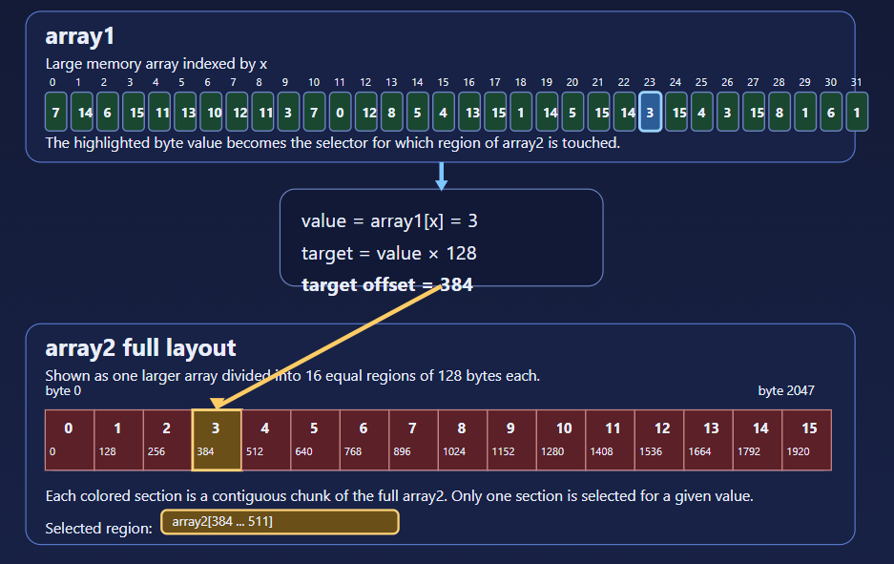
Cache Attack → Memory Leakage
array2[ secret_value * 128 ]
We use secret_value as an index into an array we control
This solves the “cache means we don’t learn exact value” problem.
But we don’t actually have ability to read secret_value

Slide 6
Pipeline with Branch
Clock Cycle: 1 2 3 4 5
Fetch
0x00a5d463
0x952e
0x8082
0x8d0d
0x8082
0x00a5d463
0x952e
0x8082
0x8d0d
0x8082
Decode
bge a1,a0,16 <.L3>
add a0,a0,a1
💀
sub a0,a0,a1
Execute
PC =.L3 if a1 ≥ a0
💀
Time
Storage Media
NOTE: in RISC-V a0/a1/etc are general-purpose registers.

Slide 7
Pipeline Flush
Flush:
Control flow change means pipeline had the wrong instructions – need to throw away the current contents.

Slide 8
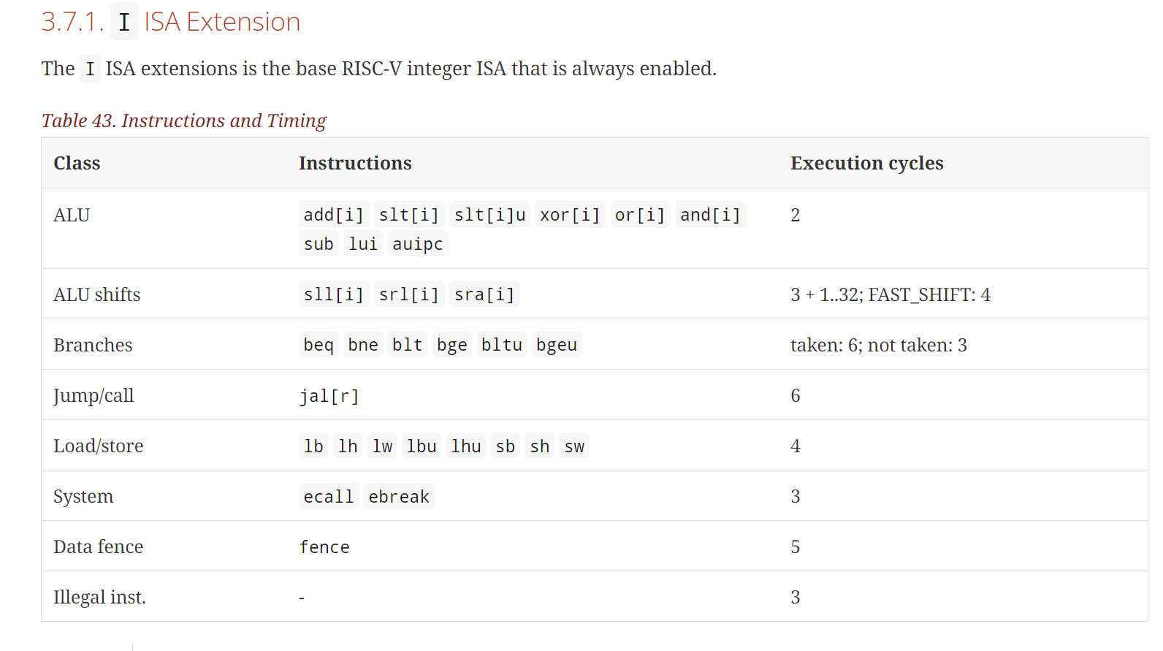
e.g. Typical Specifications – Instruction Latency
https://stnolting.github.io/neorv32/

Slide 9
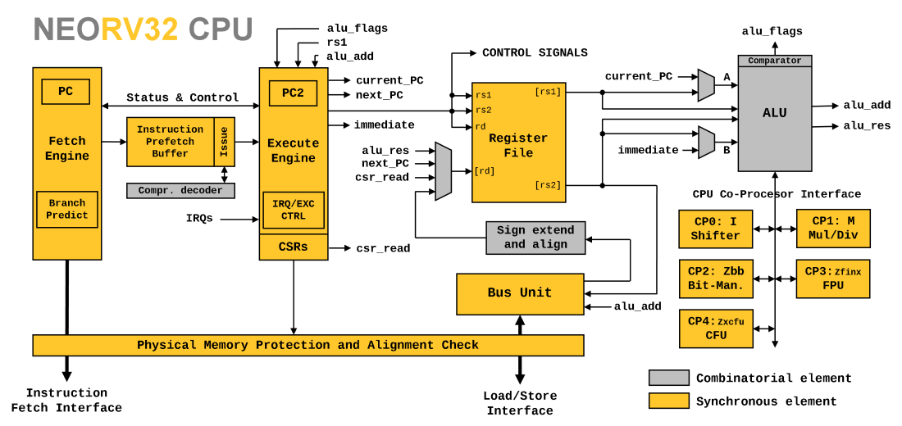
Example: A Simple CPU Architecture

Slide 10
Branch / Pipeline Stall
Q: In previous example – why not just stall pipeline until result is known?
A: Don’t know about the branch until “later” in pipeline.
A: It’s more efficient to just assume branch isn’t taken & keep pipeline up. If branch is random you are right 50% of the time, rather than stalling 100% of the time.

Slide 11

Branch Prediction
What if we could predict which branches that will be taken? Could get better than 50%! Don’t need time travel even…

Slide 12
Motivation for Branch Prediction
loop(char*, int):
addi sp,sp,-16
sw s0,8(sp)
sw s1,4(sp)
sw s2,0(sp)
sw ra,12(sp)
mv s2,a0
mv s1,a1
li s0,0
.L6:
blt s0,s1,.L7
lw ra,12(sp)
lw s0,8(sp)
lw s1,4(sp)
lw s2,0(sp)
addi sp,sp,16
jr ra
.L7:
add a5,s2,s0
lbu a0,0(a5)
addi s0,s0,1
call process_byte(char)
j .L6
for(int i = 0; i < datalen; i++){
process_byte(data[i]);
}

Slide 13
Motivation for Branch Prediction
In this loop example → branch will be taken continuously until only the final iteration. Imagine if datalen = 512, branch not taken 0.195% of time!
The default pipeline behaviour of “assume branch not taken” will have a large (negative) impact on this code-path!
e.g., for NEORV32, adds +3 additional cycles to the loop iteration each time it’s wrong.

Slide 14
Branch Prediction Example: Pentium
Branch prediction logic: holds some statement information about latest N seen branch instructions. This state indicates the likely output of the branch:
History Bits | Resulting Description | Prediction made | If branch taken | If branch not taken
11 | Strongly Taken | Branch Taken | Remains in same state | Downgraded to weakly taken
10 | Weakly Taken | Branch Taken | Upgraded to strongly taken | Downgraded to weakly not taken
01 | Weakly Not Taken | Branch Not Taken | Upgraded to weakly taken | Downgraded to strongly not taken
00 | Strongly Not Taken | Branch Not Taken | Upgraded to weakly not taken | Remains in same state
https://www.geeksforgeeks.org/branch-prediction-in-pentium/

Slide 15
Branch Prediction to Speculative Execution
Systems may speculatively execute instructions once we have branch prediction.
Based on predicted branch, load new data into pipeline, and start executing it if something is slow (e.g., waiting on memory).
Need to “unwind” any executed instructions if branch wasn’t taken.
e.g., can’t start writing to registers yet!

Slide 16
Array Lookup
Assume we had some array lookup routine like this:
char generic_lookup(char * data, int i){
if (i < 256){
return data[i];
}
return 0;
}
Bounds checking (security!!!)

Slide 17
Array Lookup (No Bounds Checking)
Without bounds checking, attacker could take this function:
And do this:
char generic_lookup(char * data, int i){
if (i < 256){
return data[i];
}
return 0; }
generic_lookup(valid_array, 4000028);

Slide 18
Speculative Execution & Prediction
char generic_lookup(char * data, int i){
if (i < 256){
return data[i];
}
return 0;
}
generic_lookup(char*, int):
li a5,255
bgt a1,a5,.L11
add a0,a0,a1
lbu a0,0(a0)
ret
.L11:
li a0,0
ret

Slide 19
Speculative Execution & Prediction
read_another_array(char*, int):
li a5,255
bgt a1,a5,.L11
add a0,a0,a1
lbu a0,0(a0)
ret
.L11:
li a0,0
ret
This load gets executed even if our “safety condition” is false (out of bounds read).
This causes data to get loaded into the cache!
We now have part of a cache-timing attack on memory we can’t otherwise touch!
But this doesn’t let as read anything still, as execution was blocked (even though cache was loaded). What to do…

Slide 20
Spectre – Reading Specific Values
Value of array1[x] (e.g., the value of that memory) is used to Index array2.
NOTE: array1 & array2 are some “non-sensitive” memory.
if (x < array1_size)
y = array2[ array1[x] * 128 ];
Memory we can read normally.

Slide 21
Spectre – Reading Specific Values
Value of array1[x] (e.g., the value of that memory) is used to Index array2.
NOTE: array1 & array2 are some “non-sensitive” memory.
if (x < array1_size)
y = array2[ array1[x] * 128 ];
Memory we can read normally.

Slide 22
Spectre – Reading Specific Values
array2[]
array2[] address doesn’t matter. We just use it to measure the cache status.
if (x < array1_size)
y = array2[ array1[x] * 128 ];
This causes array elements to be spread over larger area, making it more obvious what input value was
enc_key
array1[]
Secret is held after array1[] in memory.

Slide 23
Spectre – Reading Specific Values
if (x < array1_size)
y = array2[ array1[x] * 128 ];
array2[]
Train branch predictor by sending valid values of ‘x’.
Send a value of ‘x’ allowing you to access data in enc_key (which will be blocked by if statement)
Speculative execution happens before execution blocked, the speculative execution does the value lookup from enc_key, and then does the lookup into array2[]
Use cache probe to figure out what address of array2[] was loaded in speculative execution.
From address, calculate value of enc_key loaded
enc_key
array1[]

Slide 24
Another Way: Meltdown
Meltdown is a related attack that also takes advantage of speculative execution & cache timing attacks.
Normally if you access memory you don’t have permission to read an exception is raised.
But speculatively accessed memory has no exception raised!

Slide 25
Another Way: Meltdown
It turns out the memory is accessed (and thus cached) before the permission check happens in the implementation.
You CAN do a cache timing attack against memory you don’t have permission to read….
…but there would be exceptions raised.
Speculatively accessed memory has no exceptions raised!!
Meltdown simply makes the cache-timing attack practical, since we don’t generate the exceptions.

Slide 26
Microarchitectural Side Channels
These sorts of microarchitectual attacks take advantage of the microarchitecture (implementation) of microcontrollers.
Speculative execution has lead to a number of leaks, generally based on the principles discussed here.

Slide 27
Important Summary
The architecture of devices, such as the cache & instruction speculative execution logic, leads to many side channels.
Spectre & Meltdown Both Result in much more powerful attacks than only Cache Timing attacks

